Slide 1
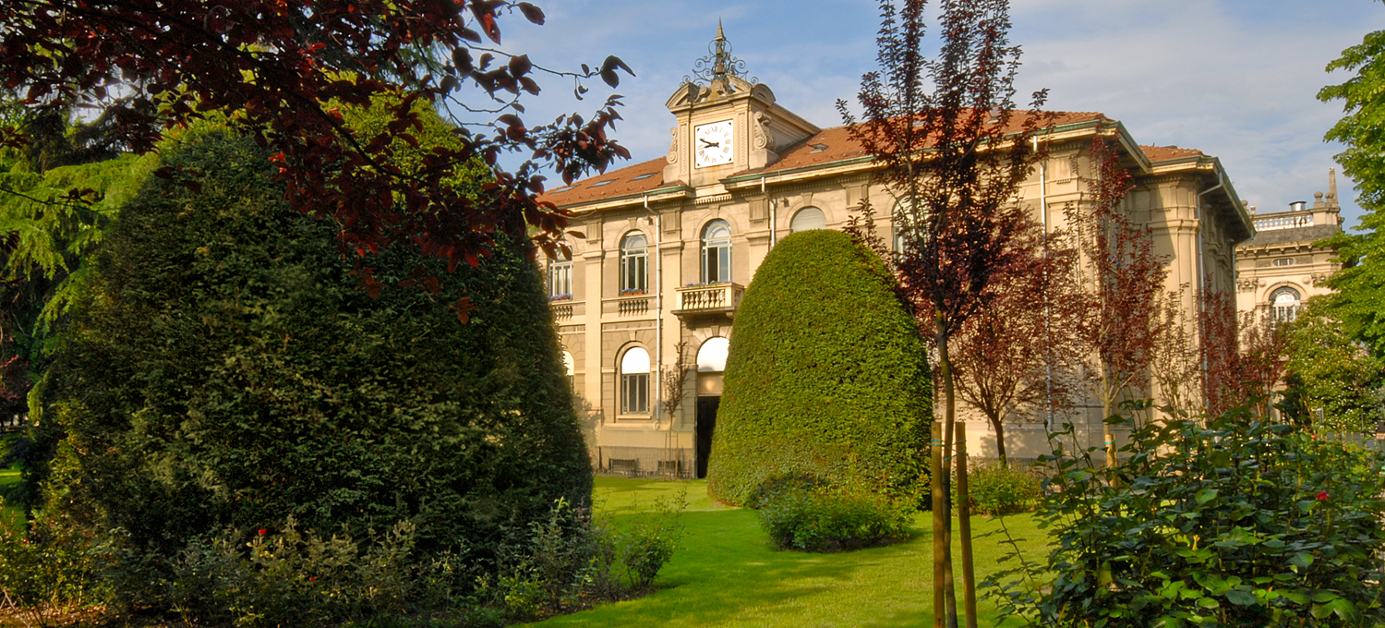

Titolo presentazione sottotitolo
Biomolecular Modelling Laboratory
17/12/2025
Milano, XX mese 20XX
Veronica Di Gennaro – 278187
Beatrice Lino – 259093
Leonardo Scappatura – 276285

Slide 2
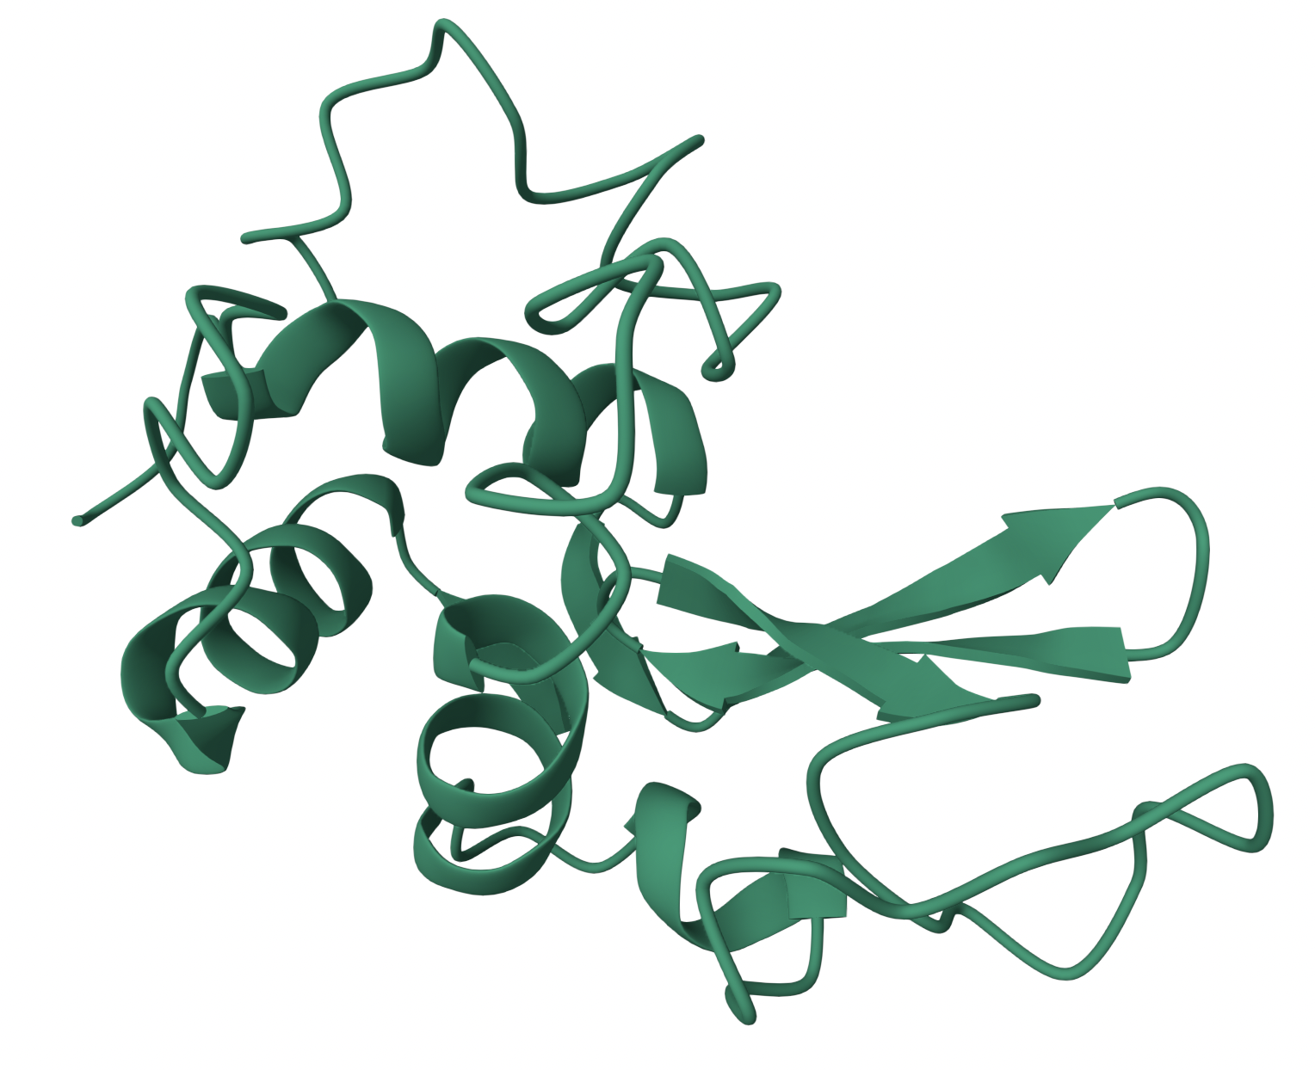
Protein 2LYZ
2LYZ is the Hen Egg-White Lysozyme (HEWL)
Hydrolytic enzyme involved in bacterial cell wall degradation
Structure solved by X-ray diffraction and deposited in the Protein Data Bank (PDB)
Biological function: cleavage of β(1→4) glycosidic bonds in peptidoglycan
Globular protein compose of α-helices, β-sheets, and coil regions

Slide 3
Project goal and strategies
Goal
Enhance structural stability of the protein
Strategies
MD simulations
Structural analysis
Mutation and energetic pretiction with FoldX

Slide 4
Simulations setup
Simulation temperatures: 300K, 400K and 500K
Data analysis:
  secondary structure evolution
  RMSF
  Q-Value
  Immagine RMSF simulazioni di prot WT
→ ARG21, LEU75 and ASP101 resulted as the most instable amminoacids

Slide 5
Rationale of selected mutations
Residue | Structural context | Mutations
ARG 21 | H-bonds and aromatic contacts | Flexibility reduction, but manteinance of interactions
LEU 75 | H-bonds | Packing optimization
ASP 101 | Near to aromatic rings | Charge modification to enhance stability
→ Mutations were designed to enhance local interactions, not to disrupt the global structure

Slide 6
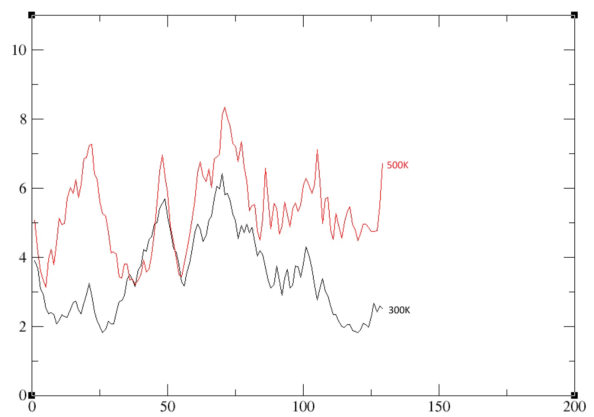
Results of the simulations
sostituire ASP101 con ASN; gly71 e arg114

Slide 7
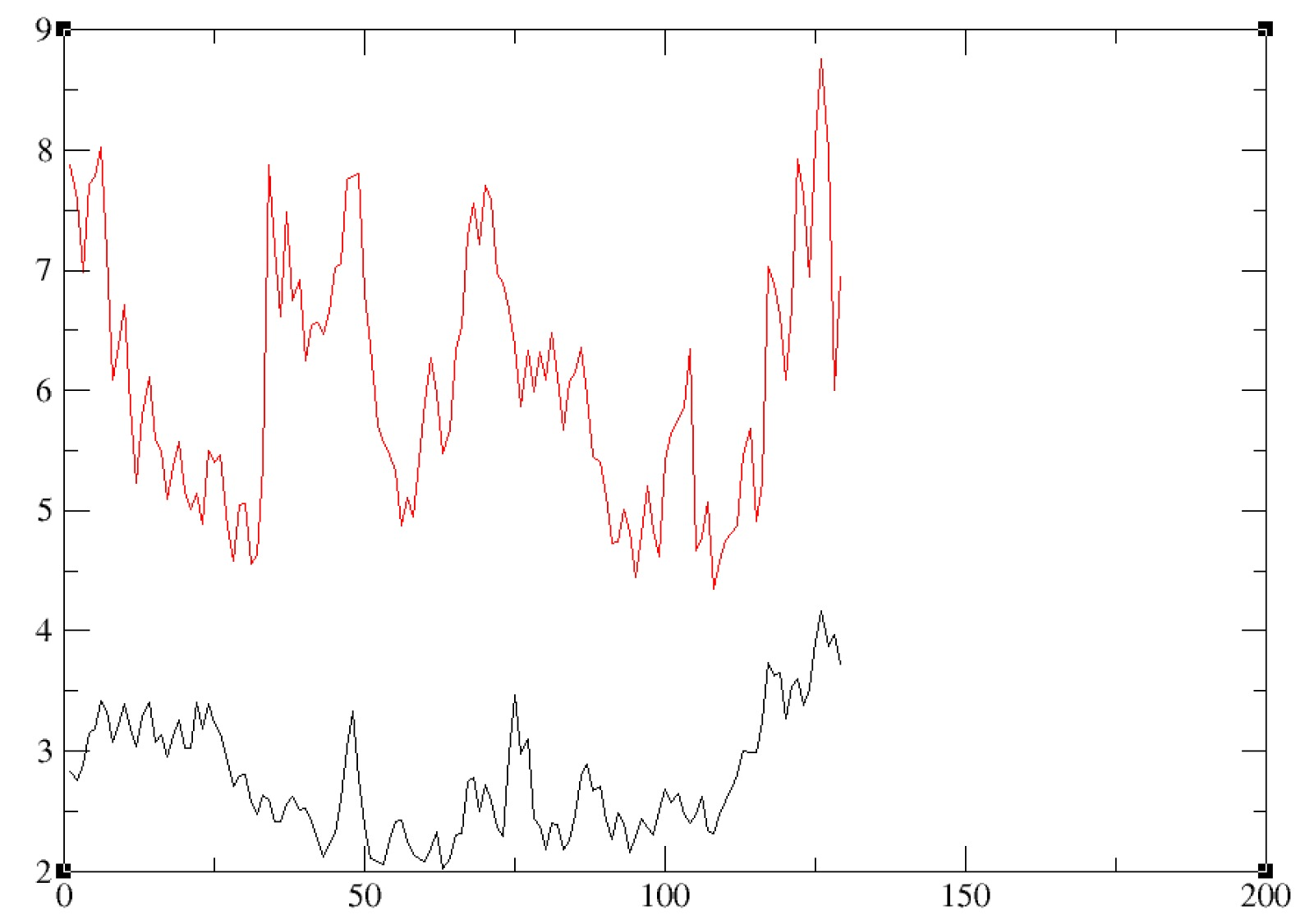
Results of the simulations – mut 1
Che mutazioni sono state fatte esattamente

Slide 8
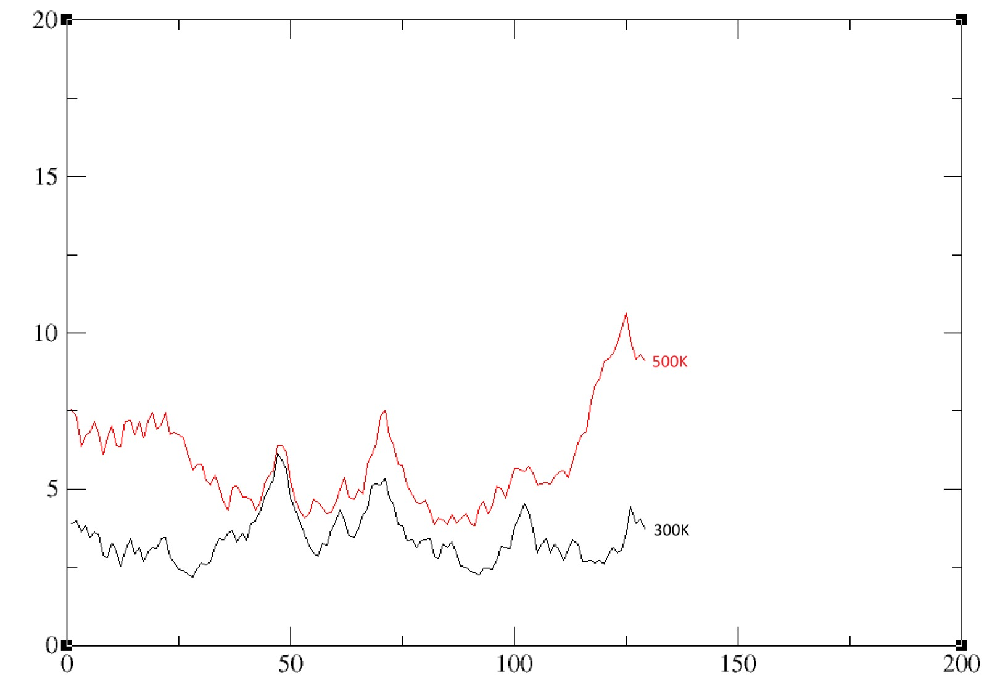
Results of the simulations
segue esattamente l'andamento sia a 500K che a 300K

Slide 9
Conclusions
High-temperature molecular dynamics simulations proved effective in identifying local instability
No mutation resulted in a clear increase in overall protein stability,
Among the tested variants, Mut3 exhibited the most favorable balance in terms of structural stability
required extensive trial-and-error process, combined with a deep understanding of residue-specific interactions and their structural and dynamical roles within the protein.

Slide 10
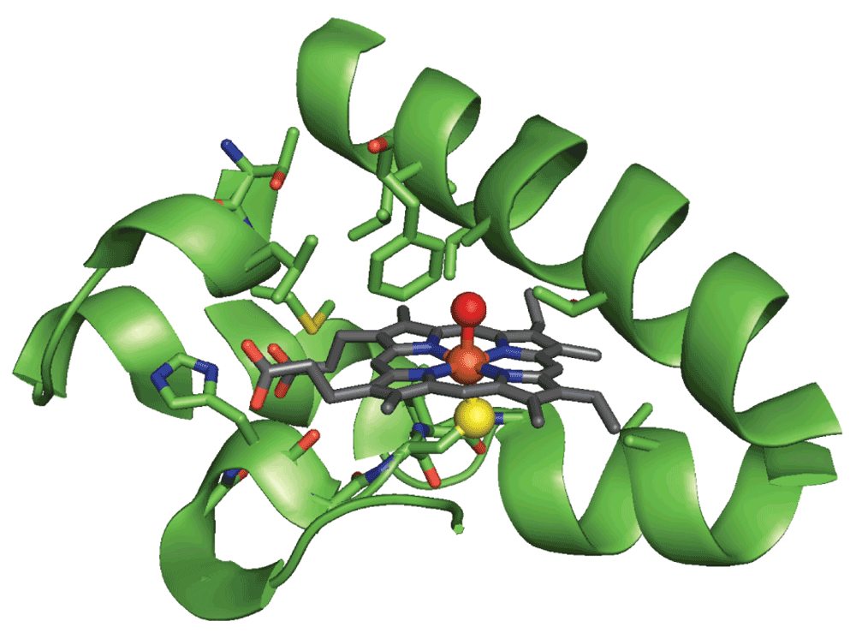
Thank you for your attention!

